Slide 1


Improve the accuracy of Pneumonia Detection from Chest X-ray using Transfer Learning
By; Nathan Angell
Notes:
Good Afternoon everyone, my name is Nathan Angell and today, I will be talking about Transfer learning, more specifically, using transfer learning to improve the accuracy of detecting pneumonia.

Slide 2
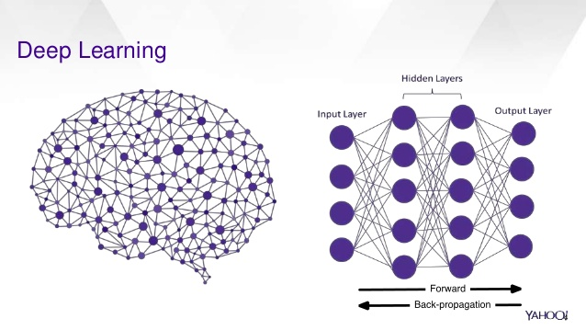
Table of Contents
What is deep learning
Transfer learning
Stepping into my pneumonia detection project, with the help of transfer learning to improve my accuracy
Conclusion
Notes:
I will be breaking this presentation into four parts. First, I will be talking about deep learning. Next, I will be describing how the transfer learning tool connects to deep learning. I will then talk about my project, pneumonia detection and finally I will wrap it up and summarize my findings.

Slide 3
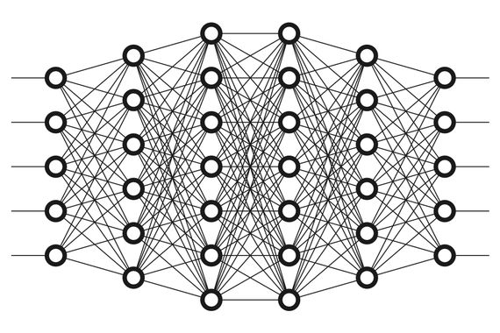
Deep learning
Deep learning Extract patterns from data
There are many benefits to deep learning
Big Data
Notes:
For first bullet
deep learning is a subset of the Artificial Intelligence ecosystem. Deep learning extracts patterns from data using neural networks as a guide. The deep learning algorithm mimics the human brain by connecting many nodes together, just like what you see in the picture to the right. By mimicking the human brain, it can achieve far better results than any other machine learning algorithm.
For second bullet
there are many benefits to deep learning. With the help of deep learning, many competitions that used deep learning as the foundation of their algorithm, got a significance performance increase. No other model came close to deep learning’s accuracy. In applications like, Google’s deep learning AlphaGo program, defeating a professional Go Player or Google’s deep learning translation tool blowing out every other language translation technique.
For third bullet
as more data gets uploaded to the internet, the more importance deep learning algorithms will get. The reason is because these algorithms thrive on massive amounts of data, i.e big data. Essentially the more data that gets passed through the algorithm, the better the accuracy it can and will achieve. This is a massive difference between traditional machine learning algorithms because with most of these types of algorithms, the more data you feed into it, the accuracy or performance kind of flattens out.

Slide 4
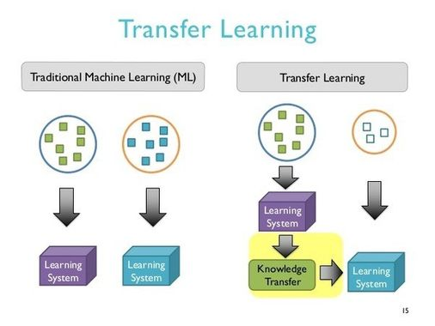
Transfer learning
Takes a long time to train a model
Transfer learning takes a lot less time and is way more accurate
Downloading transfer learning models
Notes:
First bullet
before transfer learning, it took a long time to train a model, especially for a large dataset. This was because, the model must compute each node’s weights from scratch. By using many layers, like what we saw in the previous slide, and connecting them it can get very complicated and time-consuming task.
Second bullet
to solve the dilemma of taking too much time and getting less accurate results, people or more specifically companies like Google, developed this tool called transfer learning models. Basically, Google created a very large dataset with a couple million images attached to it, so that the model can learn and extract patterns from the dataset.
Third bullet
because Google’s transfer learning models had a vast dataset, it took a long time for the algorithm to train. Nonetheless, when the model completed its work, Google developers created a system where they allowed the knowledge of that model to be transferred over to people like me for detecting pneumonia.

Slide 5

Computation Set Up
Google Colab
Free service offered by google
It provides GPU computation
Notes:
I used Google Colab for creating this deep learning model. This is a free service offered by Google and it runs just like how Jupyter notebooks operates but it runs solely on the cloud rather than running locally on your machine.
Most importantly, the notebook you are working on can be edited simultaneously with different team members, just like how google docs works.
With using the cloud, the service can provide more GPU computation. Meaning, with more GPUs at your disposable, it’ll take less time to complete the model.

Slide 6
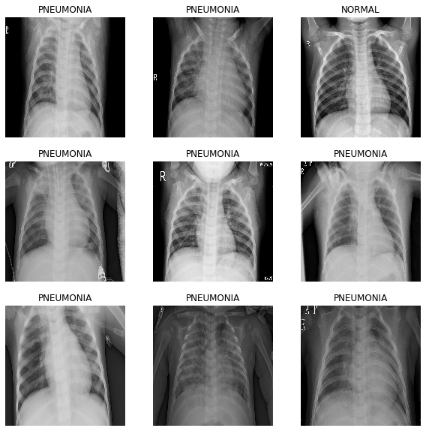
Data
5216 images for training
690 images for validation
Notes:
First bullet
I collected 5,216 images that contained pictures with and without pneumonia, as you can see from the picture to the right. These images will be used to train the deep learning model. The dataset was offered to me, free of charge, by a public library called Kaggle.
Second bullet
I then had 690 images for validation. These will be used to assess the model’s accuracy, based upon what the model learned from the training dataset.

Slide 7
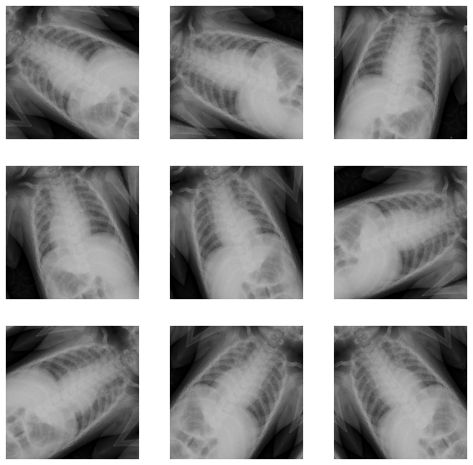
Data augmentation
Explanation
More data to train
Reduce overfitting
Notes:
Having a couple thousand images is a good starting point for creating a model. Nonetheless, it is always a good practice to create more data, if you have the opportunity. That is where data augmentation comes in. You can apply data augmentation by transforming the images by rotating them either horizontally or vertically.
We chose to rotate them horizontally. This not only, like I said before, creates more data, but it also allows us to reduce overfitting. Overfitting occurs when the model knows, in full detail, the training dataset. However, if the model gets thrown new data, like from the validation dataset, it will not know if it has pneumonia or not because the only thing it knows is the training dataset.
by introducing more data to it, through data augmentation, we can reduce the impact of overfitting and allow the model to get better results, i.e. better accuracy.

Slide 8
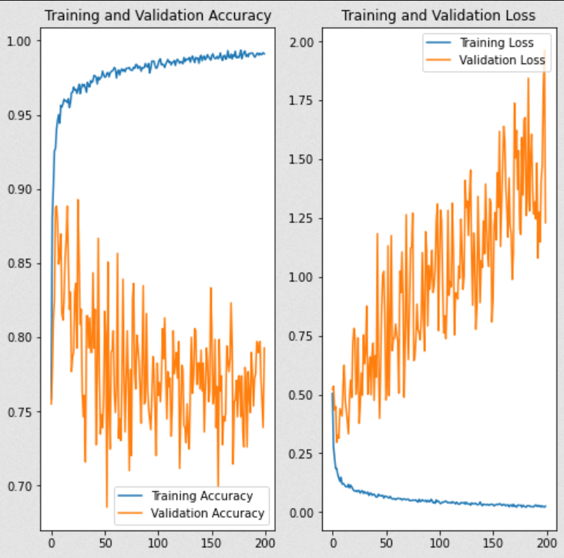
Without Transfer Learning
32 images
200 epochs
Best accuracy: 89.28%
Notes:
First bullet
The 5,216 images we have for the training dataset, was split into 163 batch sizes, each batch contains 32 images. The reason why we implemented batch sizes is because the model can learn and update quicker because it only has to go through 32 images instead of 5,216 images.
Second bullet
with 163 batch sizes in mind, we created 200 epochs for the deep learning algorithm to run through. As the model runs through the data, we initially thought that it will retain better accuracy. However, we were wrong. As the model ran through more epochs, the less accurate the model got to be.
Third bullet
as a result, the model without transfer learning, our best accuracy was 89.28% at an epochs of 26.

Slide 9
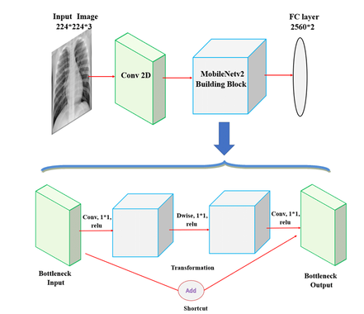
MobileNetV2
Total params: 2,259,265 Trainable params: 1,281 Non-trainable params: 2,257,984
Total params: 2,259,265 Trainable params: 1,281 Non-trainable params: 2,257,984
Designed by google
Trained on ImageNet dataset
Total params: 2,257,984
Notes:
MobileNetV2 is transferred learning model that I chose for my dataset. Now, there are many different transferred learning models, but I thought this was the best fit for me. This specific model is designed by Google and is trained on ImageNet dataset. This dataset contains around 1.2 million training images, 50,000 validation images and 100,000 test images. Because of the vast dataset that it was trained on, it has a total of 2,257,984 parameters, meaning that it is a very deep model that has a lot of learning attached to it.

Slide 10
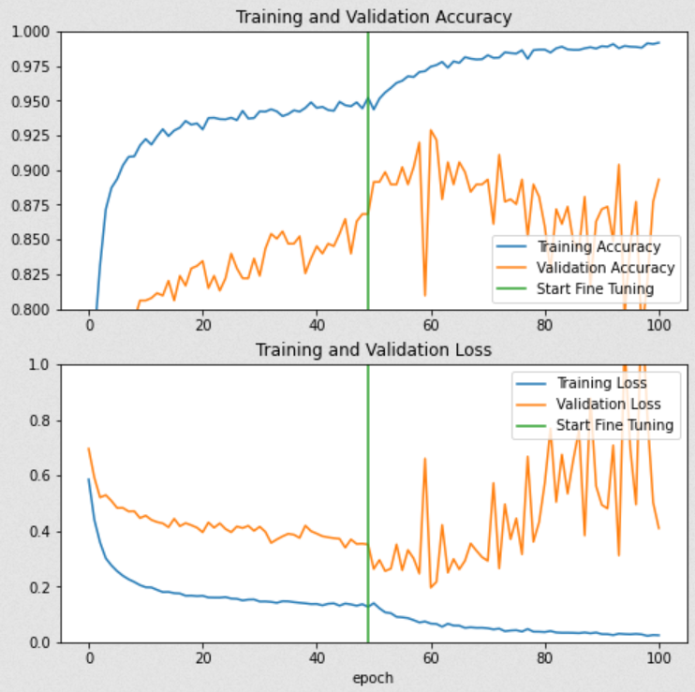
With Transfer Learning
MobileNetV2
50 epochs
Freeze = False
With an additional 50 epochs
Best accuracy: 92.88%
Notes:
If you look at the orange line, running through the MobileNetV2 transfer learning model, gave the model better accuracy
Third bullet
as the model goes passess the green line, you can see that the model gets more accurate. This is because we set the freeze equal to false. By setting Freeze to false, it essentially allows us to edit more of the transfer learning model’s parameters, to better fit our pneumonia dataset. Or another way of putting it, when the process of running the model starts, we are essentially allowing the model to edit only 1,281 of the 2.2 million parameters. This will make sure that when the model looks at our data, it can better detect pneumonia.
Fourth bullet
as a result, with an additional 50 epochs, we get our best accuracy of 92.88% at an epochs of 60.

Slide 11
Conclusion
Deep learning
Transfer learning
Are there are questions?
Notes:
first bullet
deep learning is and will continue to be a very important algorithm in every aspect of our lives. Such as, Google’s deep learning AlphaGo program defeating a professional Go Player or Google’s deep learning translation tool blowing out every other language translation technique.
Second bullet
transfer learning is an invaluable tool that builds on top of deep learning to make it more efficient and to achieve a better accuracy. Traditionally, without transfer leaning, deep learning algorithms require millions of images to train, to get an accurate result. But with transfer learning enabled, I was able to train a small dataset, around 10,000 images, to get an accuracy of 92.28%
Third bullet
thank you for your time. are there any questions you may have?

